Slide 1

Purdue Northwest University
INVERSE MODELING FOR HOUSE VALUE PLANNING
NEURAL INPUT OPTIMIZATION (NIO)
– By
Rahul Reddy Mudhuganti
Ananya Boinpally
Jeevana Shruti Kunuku

Slide 2
Overview
  Build a regression model for predicting house values
  Freeze the trained model
  Use Neural Input Optimization (NIO) to find inputs that achieve a target house value
  Demonstrate inverse prediction + constraint optimization
  Evaluate the system and deliver results

Slide 3
  Traditional ML predicts outputs from inputs
  Real-world planning needs the reverse: “What conditions lead to a target outcome?”
  NIO allows optimization directly over inputs
  Applicable for pricing, planning, forecasting, and recommendations
Problem Motivation

Slide 4
What is NIO?
  Model weights become fixed
  Input vector becomes trainable
  Apply gradient descent on inputs
  Add constraints (income range, latitude/longitude, etc.)
  Run optimization until model output ≈ target

Slide 5
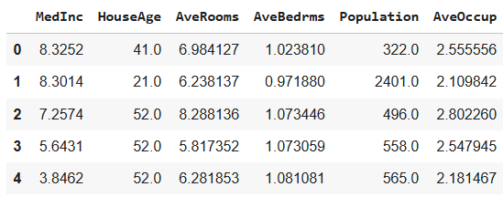
Dataset Used
California Housing Dataset
  Median Income
  House Age
  Average Number of Rooms
  Average Bedrooms
  Population
  Latitude
  Longitude
  Median House Value

Slide 6
  Missing value check
  Normalization (Min-Max / StandardScaler)
  Train-test split
  Data visualization for correlations
Preprocessing

Slide 7
Model Architecture
  Fully connected feedforward neural network
  ReLU activation
  Output: single value (house price)
  Optimizer: Adam
  Loss: Mean Squared Error (MSE)

Slide 8
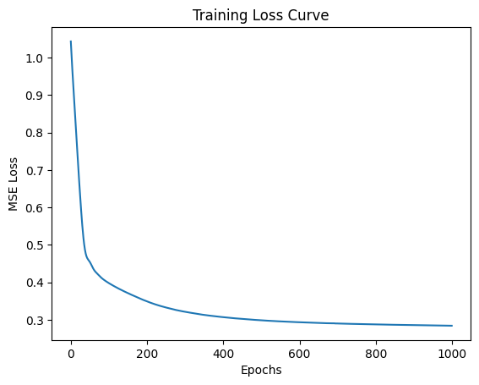
Training Results
  Smooth loss convergence
  Low validation error
  Model generalization is stable
  Ready for NIO phase

Slide 9
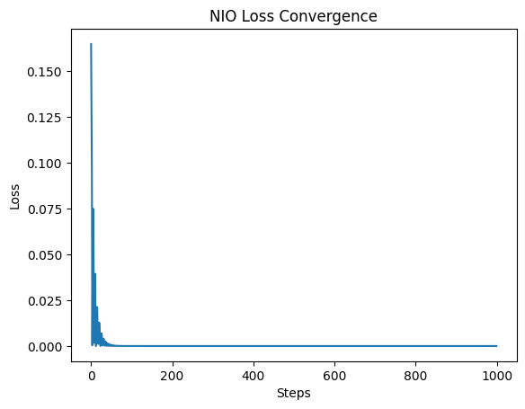
NIO Optimization Phase
  Initialize random input vector
  Make it trainable
  Define target house value
  Run optimization until predicted value matches target
  Clamp/clip inputs to realistic bounds

Slide 10
Constraint Handling
Examples:
  Median Income: 1–15
  House Age: 1–50
  Rooms: 1–15

Slide 11
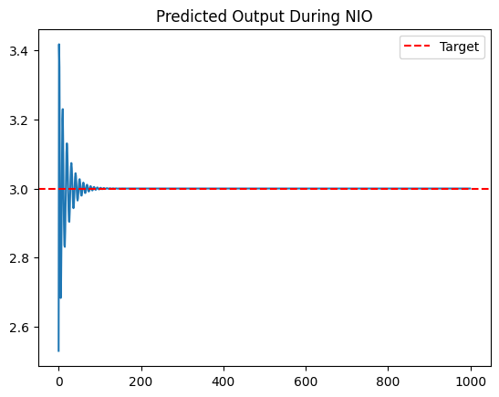
Results of NIO
  Model successfully finds feasible housing conditions
  Matching error < 1% to target value
  Inputs are realistic and interpretable

Slide 12
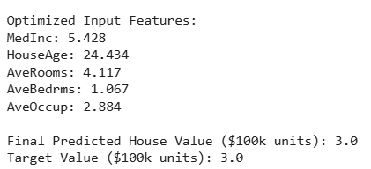
Analysis
  Higher income leads to higher target prices
  Room count and location also influence strongly
  Optimization converges within 300 steps

Slide 13
Evaluation
Strengths:
  Demonstrates full inverse modeling
  Consistent with research frameworks
  Extensible to other domains
Limitations:
  Sensitive to model accuracy
  Local minima possibility

Slide 14
Conclusion
  NIO approach satisfies the professor's requirement:
    Research problem
    Model development
    Optimization
    Evaluation
  Provides interpretable planning solutions
  Demonstrates both ML + optimization techniques

Slide 15
Future Work
  Add multi-objective optimization
  Use richer U.S. datasets
  Use constraint-aware optimizers (e.g., L-BFGS-B)
  Add GUI for interactive planning

Slide 16


